Slide 1

Tablet Basics
Supervisors and Interviewers

Slide 2

Tablet Basics
Supervisors and Interviewers

Slide 3
Training plan
Do all the pre-work-reading manual and reviewing PowerPoints
Presentation >> demonstration >> practice
Enter class work first time
Mock/practice interviews
Practice practice practice!

Slide 4
Ground Rules for CAPI Training
Take care of your tablet – charge it!
Close tablets when instructed
Keep pace with trainers
Check back on instructions before asking questions
Practice as instructed
Ask questions – parking lot
Have fun!
Notes:
Check back on work to be sure no keying errors – saves everybody time
Practice like we instruct – meaning, we rarely/never tell anyone to just fill in a questionnaire without practicing interviewing

Slide 5
Remote Training
Please be patient
Before going to someone with help, try to work through it
Participation is key
Don’t hesitate to ask questions
Tracking Kiswahili translations

Slide 6
Active Interviewing
“Active” interviewing
Paying attention to sequence of questions
Catching errors/mis-keying
Read error messages
Do NOT make up data!!!
Notes:
Be an active interviewer! This means really listen to the story of the respondent – does it make sense with what they have said?
Training plan will only work if we follow ground rules

Slide 7
Security and Caring for Tablets
Care, treat well
Government property
Use for KMIS work only!
Use cases
Keep charged
Notes:
Kemi and AA will be keeping very careful track of serial numbers and checking tablets each morning

Slide 8
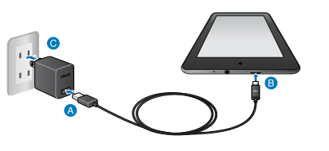
Charging the tablets
Charge whenever and wherever there is opportunity.
At night, in the car, at a restaurant…
Don’t use tablet for other activities when charging not readily available
Notes:
Supervisors will have extensions and car chargers

Slide 9
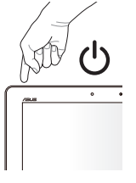
Tablet basics and passwords
Then swipe up or hit space bar to display password screen
Password:
<12345>

Slide 10
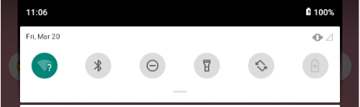
Desktop and Time
Date and Time:
MUST CHECK!
Swipe down
Times of interviews are automatically recorded… if tablet time is wrong, system may crash, data may be lost!
If wrong, contact IT expert at Implementing Agency

Slide 11
Powering down
Press the button on the upper right side and hold it down
Power down as often as possible!
Shutting tablets between households is sufficient – but on breaks, power down

